Slide 2
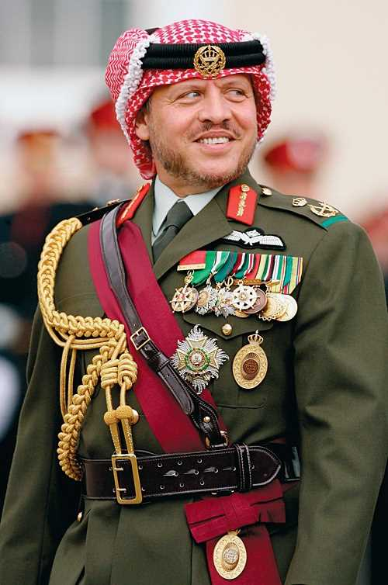
“ These young people, like young people everywhere, deserve a future they can prosper in, A future with opportunity and hope.”
HM King Abdullah II
From the keynote address at the World Economic Forum
Jordan Valley June 21, 2003

Slide 3
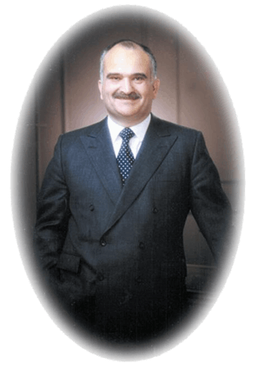
“The sought generation is a generation of volunteers who can take on the responsibilities and duties of the country.”
HRH Prince El-Hassan bin Talal
HRH Prince El Hassan Bin Talal
Founder of HYA

Slide 4
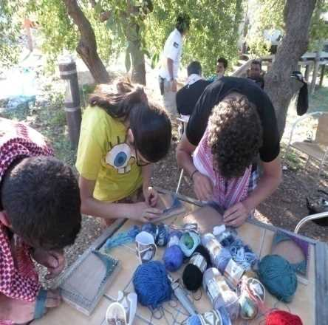
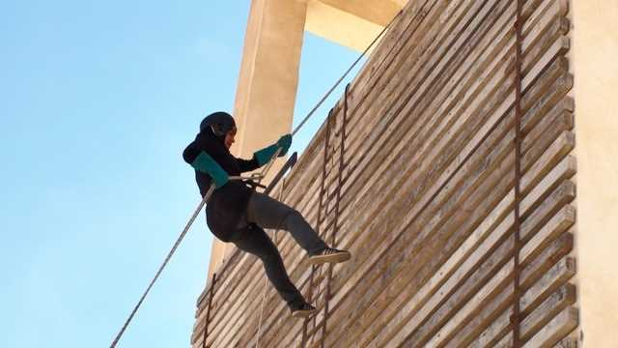
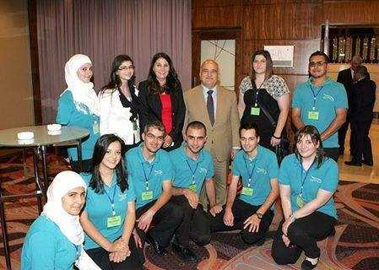
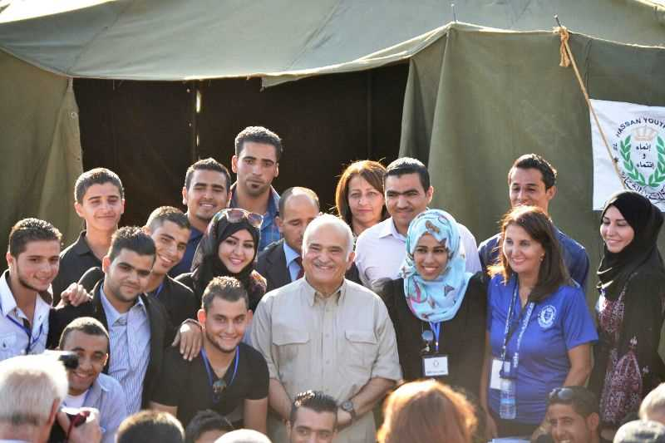
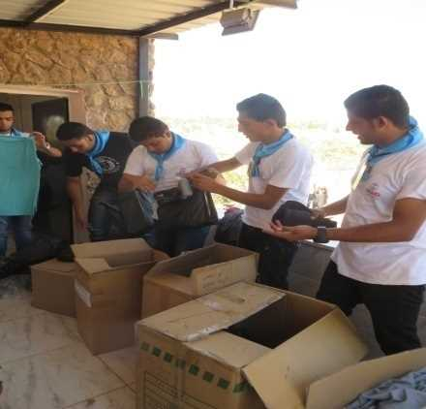
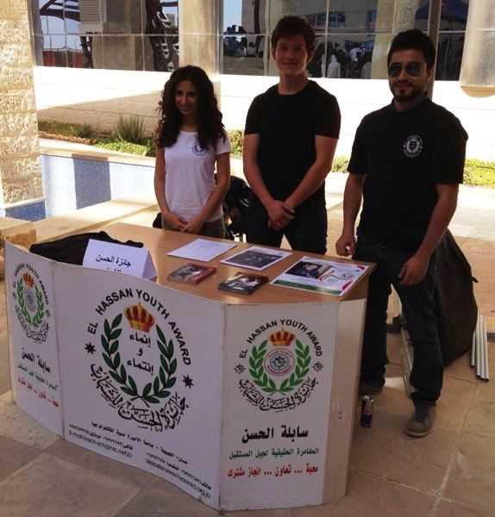
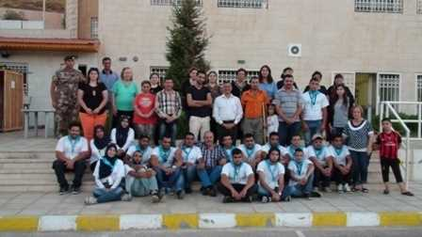
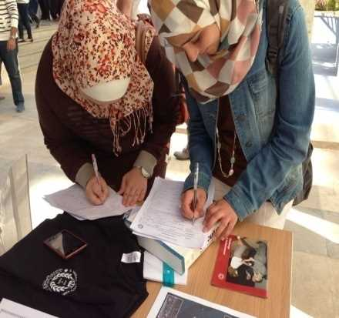
Development and Affiliation
The Key to this slogan lies in understanding the meaning of the two words inscribed in the middle:
The first is “development”- to work, in whole and not in part, on the spiritual, emotional, and moral development of the youth including their mental and physical development,
and the second is “affiliation” to God, Country and King as indicated by the first symbol: the Crown. The second symbol is the wheat stem firmly rooted into the ground to indicate affiliation to Jordan first, the greater Arab homeland and humanity as a whole.
Earth means identity
language and the ability to unleash the energies of the individual and the community
altogether as the source of unlimited giving, altruism and excitement.

Slide 5
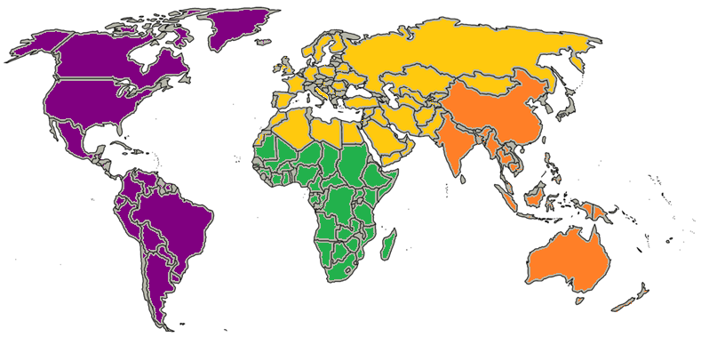
Europe, Mediterranean & Arab States Region
Americas Region
Asia Pacific Region
El Hassan Youth Award Regional Consult Centre for Arab States
Africa Region

Slide 7
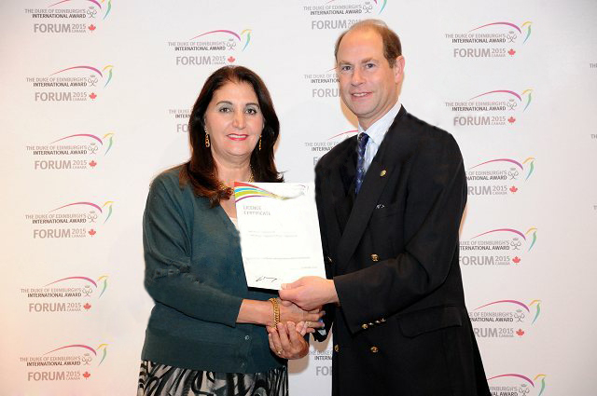

Slide 8
Philosophy
Individual
Non-competitive
Voluntary
Balanced
Achievable
Progressive
Inspiration
Development
Persistence
Enjoyable

Slide 9
HYA Levels
Sabelt El Hassan 25-17
Year
Award Award 16 Years
Silver Award 15 Years
Bronze Award 14 Years

Slide 10
Aims
Develop the Youth to enhance :
Self reliance and self control
Social responsibility and dedication.
Perseverance and determination.
Initiative and originality (creativity).
Value oriented decision making.
The spirit of adventure.
Fitness of the body and mind.
Life skills, professional skills, cultural skills, and family related skills.

Slide 11
The Four Programs
The Four Sections of The Award

Slide 12
Services
Aim: to learn how to give useful services to others through:
Community service projects.
Conservation work
Voluntary service in hospitals or community homes
More specialized training such as lifesaving, first aid or rescue services.
The emphasis of this section is on the regular giving of services.

Slide 14
Skills
Aim : to encourage the development of personal interests and practical skills.
There is an almost unlimited choice of skills, including : arts and craft, computing, vocational skills, hobbies or music.
Sustained effort and general improvement over a period of time is
required, challenging, improving and broadening personal interests.

Slide 16
Physical Recreation
Aim: to encourage improved performance and physical fitness.
Participants are required to take part in some form of organized physical recreation and show individual sports, such as ball sports, water sports, martial arts and athletics. Other physical activities include rock- climbing, dancing and yoga.

Slide 18
Adventurous Journey
Aim: to encourage a spirit of adventure and discovery whilst undertaking a journey in a group.
The journey may be an exploration, expedition or an other adventurous journey and can be done by foot, bicycle, boat, horseback etc. Proper training and preparation, self-reliance and the exploration of new surroundings are the key elements.

Slide 20
Residential project
Young people are required to undertake a residential project at Gold Level.
This is intended to broaden their experience through involvement with others ( who are not their everyday companions) in a residential setting over a period of five consecutive days.

Slide 21
The Award and the pandemic
Future Plans

Slide 22
أصبح التسجيل في الجائزة الكتروني على موقع سجل الجائزة الجائزة المحوسب
Registration for the Award is now electronic on the Online Record Book
https://www.onlinerecordbook.org/fo/

Slide 23
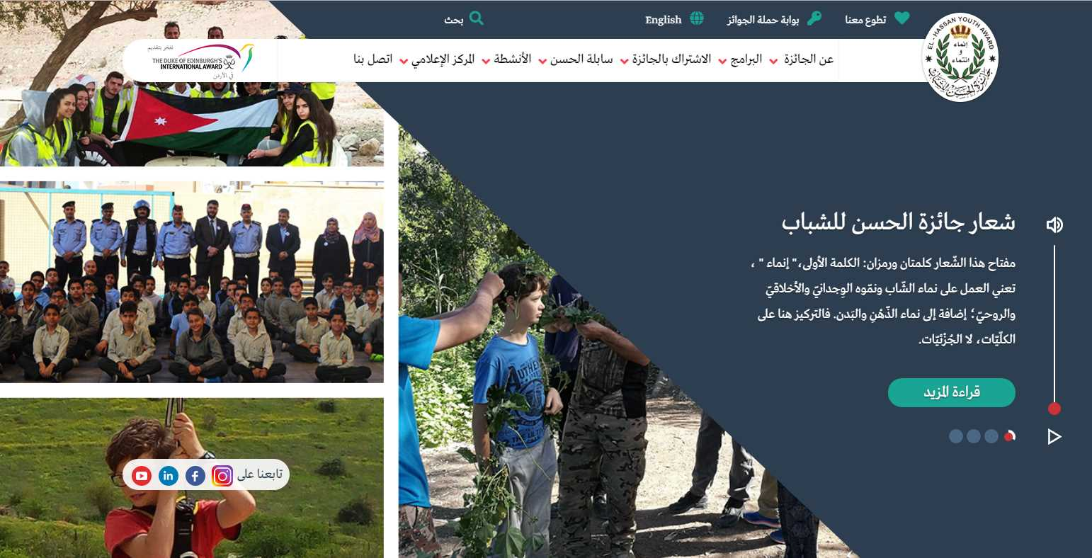
Media and visual identity
El Hassan youth Award Website
http://www.hyaward.org.jo/

Slide 24
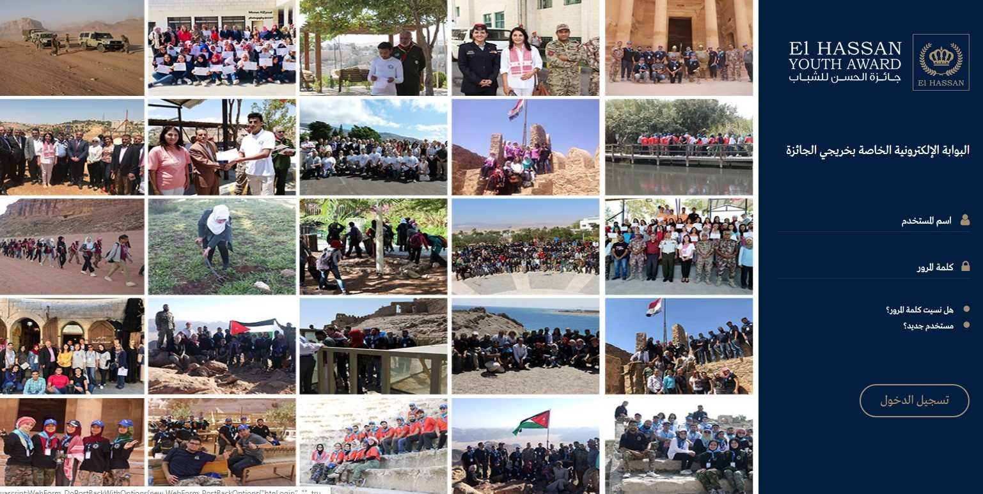
الاعلام و الهوية المرئية
http://alumni.hyaward.org.jo/
بوابة حملة الجوائز و مغامري سابلة الحسن

Slide 25
Recommended Projects
A. Extending healthcare support to governorates across the country.
1. El Hassan Youth Award can act as a catalyst in bringing funds to the hospital (i.e., Prince Hamzah Hospital) and work out an arrangement to provide funds for setting up Covid-19 testing locations, or vaccination in under-served areas- maybe even supply them with needed medications (i.e., Vitamine D, C, antibiotics and Zinc) or other needed provisions. They can enroll volunteers from within the El Hassan Youth Award who are doctors, nurses or peers to support this endeavor by either providing logistical, managerial or liaising support. In return, they get to be vaccinated without having to wait their turn

Slide 26
A. Extending healthcare support to governorates across the country.
2. El Hassan Youth Award can conduct a healthcare needs assessment in under- served areas and refugees for Covid-19 testing, medication (i.e., Vitamine D, C, antibiotics, and Zinc). In cooperation with the Ministry of Health to determine gaps which can be filled by volunteers

Slide 27
B. Education Support
1. El Hassan Youth Award can act as a catalyst in supporting online education
for people in underserved and refugee communities. We have some good
online Arabic platforms (i.e. Darsak with the Ministry of Education and Edrak
both can provide supplementary education online to underserved areas
for specific levels and topics.) that can add value to existing education initiatives.

Slide 28
B. Education Support
2.From our experience during the COVID-19 pandemic we felt the need to transform the Award program to be online to scale and enrich the Award's online programme to build capability in accessing new frontiers for the delivery of services and skills training, and the provision of outside exposure and challenging opportunities, and during that we felt the need to provide iPADS to disadvantaged students and Award Centre and those with limited financial means and resources to access the internet, which would otherwise, be difficult without, and to the HYA online Programmes. It will increase the employment
potential of youth in a world that is becoming heavily reliant on technologies by teaching them skills fit for the digital age.

Slide 29
Our strategic plan involves under covid-19:
To build new and complimentary capabilities online by migrating services and skills training, including expeditions and physical recreation online.
To reach new members and communicate and engage more effectively with our Alumni
To raise the profile and standing of the Award as a strategic national partner and catalyst for change, especially in reducing inequalities, digital or otherwise.
This is our strategic plan going forward predicated on the premise that we shouldn't let a good crises go to waste. Rather, using it as an opportunity to scale and enrich the award activities online.
Conduct needs assessment survey for online education across underserved and refugee areas.

Slide 30
C. Agriculture & Food
1. El Hassan Youth Award embarked on ambitious projects to grow and plant food in different location in the Kingdom , so we need to get funds to support agricultural work in that location, which would then be distributed to underserved and refugee areas at cost. (Hence, providing them with tomatoes, peppers, olives, olive oil...etc.)

Slide 31
Contribution to the community
Challenge100
The Challenge100 is a great way to raise awareness and funds in support of the Award Campaigns both in-country and around the world.
1- Cleaning campaigns 100
2- Distributing clothes 100 Family
3- Activity day for 100 Orphans

Slide 32
Thank You

